Slide 1

3D print a Mars Rover
Harold Pulcher (MVP) @haroldpulcher pulcher@pulcher.biz
https://youtube.com/user/hpulcher https://twitch.tv/haroldpulcher
https://github.com/pulcher/exomy-rover
https://esa-prl.github.io/ExoMy/

Slide 2
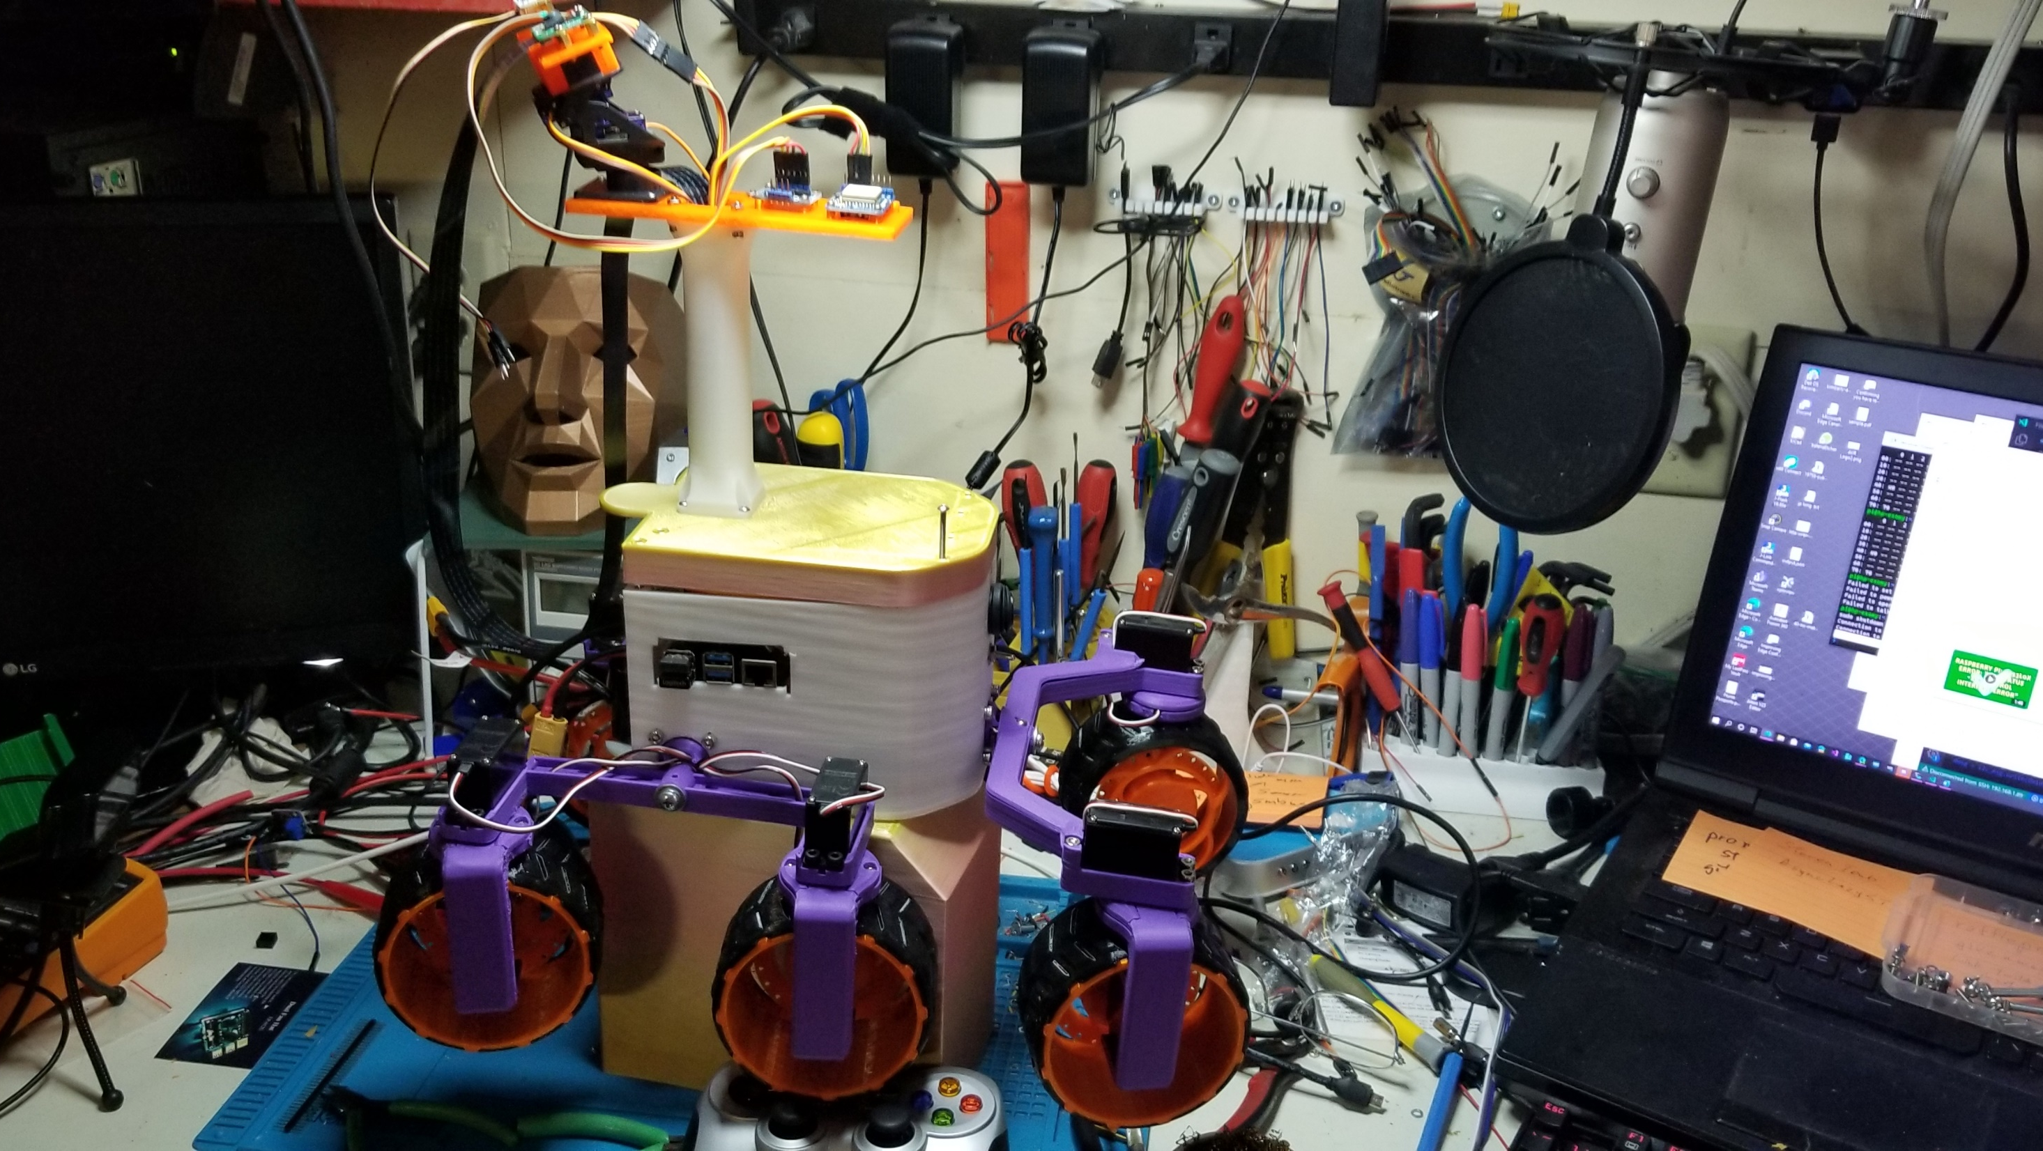
Why did I build this?

Slide 3

The Goal

Slide 4
The Tools
3D printer with at least 200x200x180
Fusion360
Soldering Iron
Set of tools that most have around the garage.

Slide 5
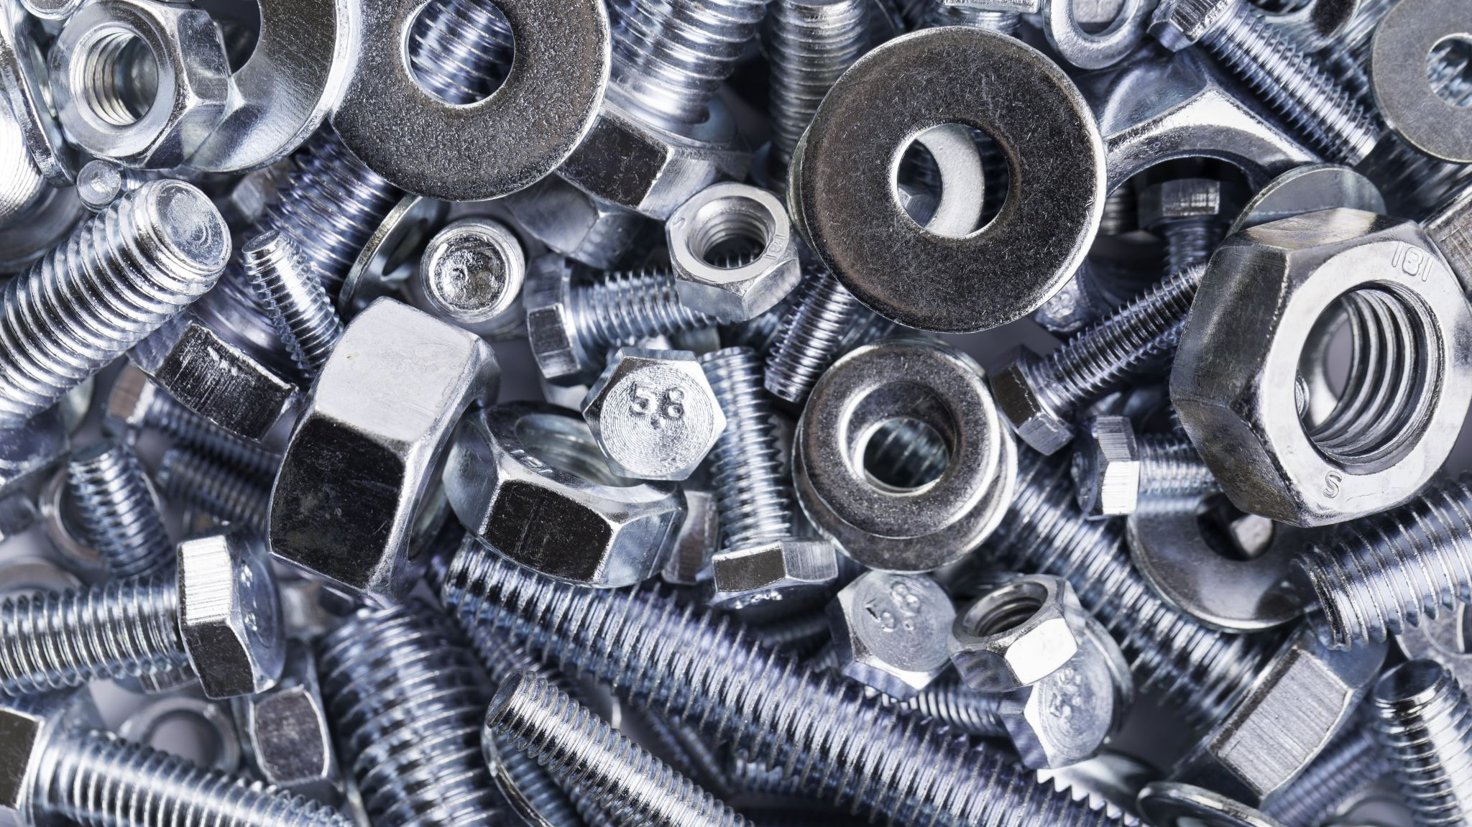
The Parts

Slide 6
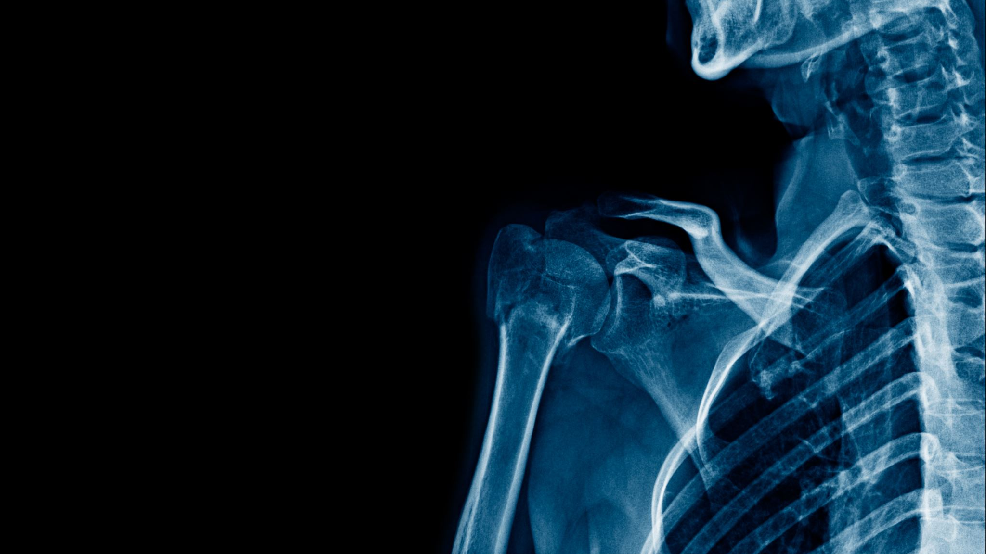
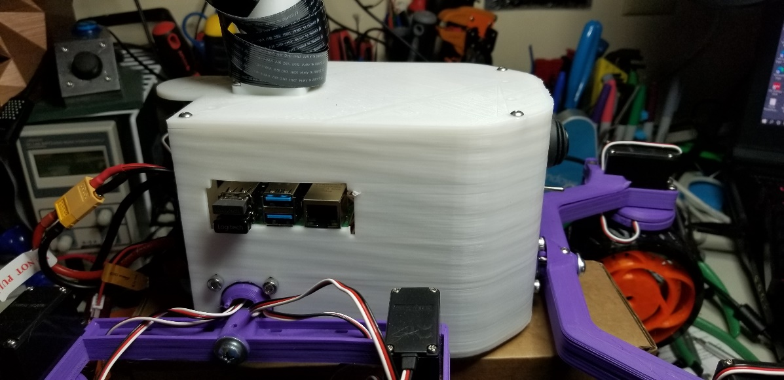
Parts: Body

Slide 7

The Body

Slide 8
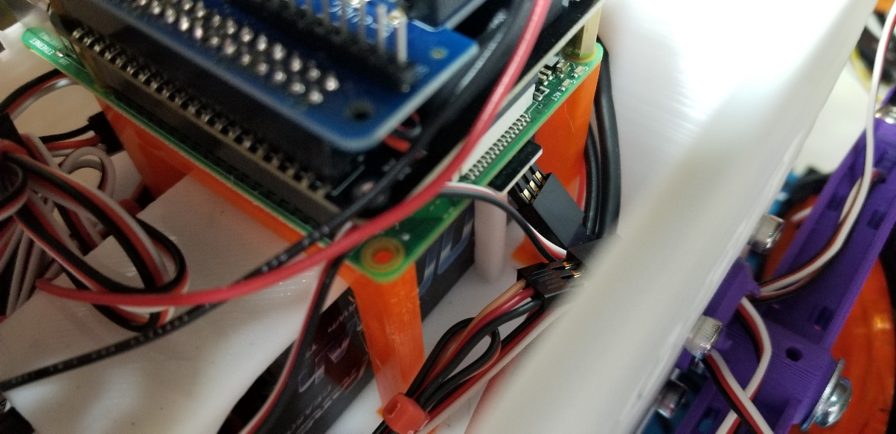
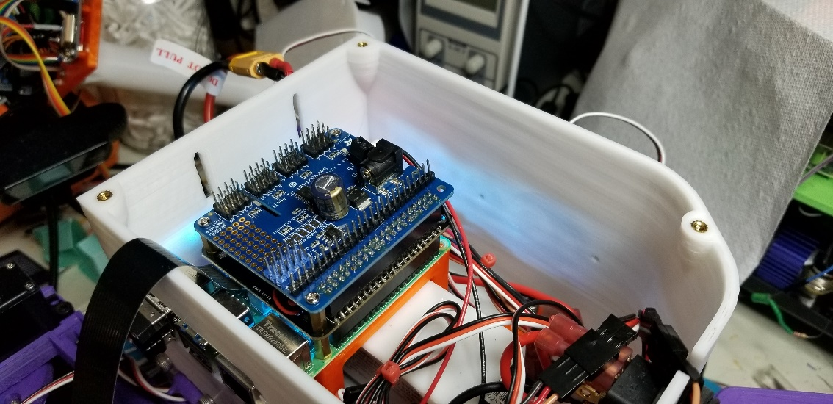
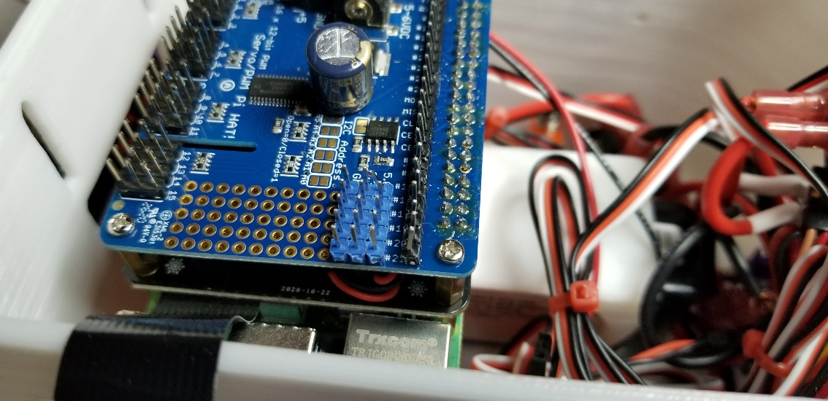
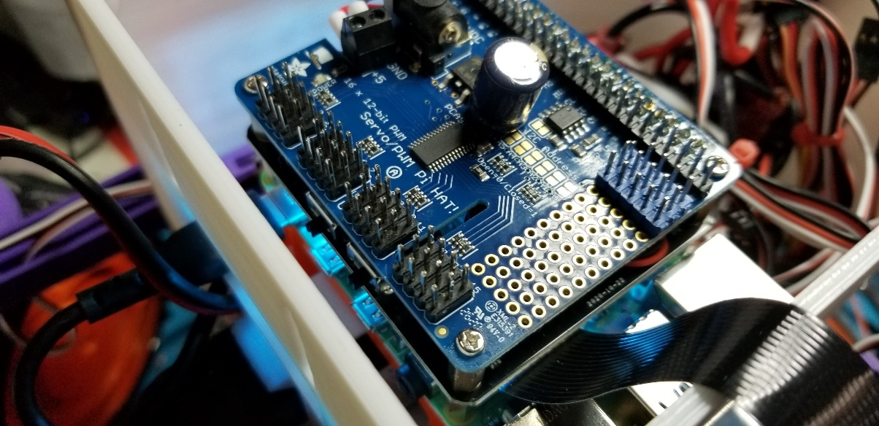
Parts: Internal Body

Slide 9
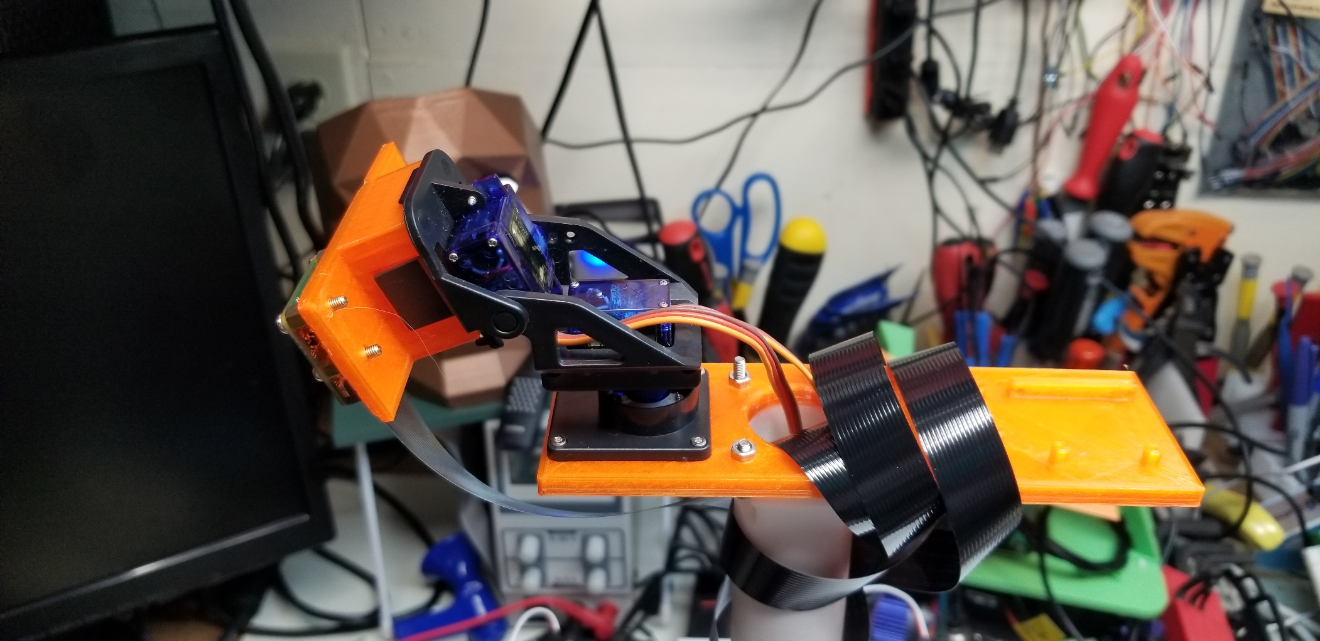
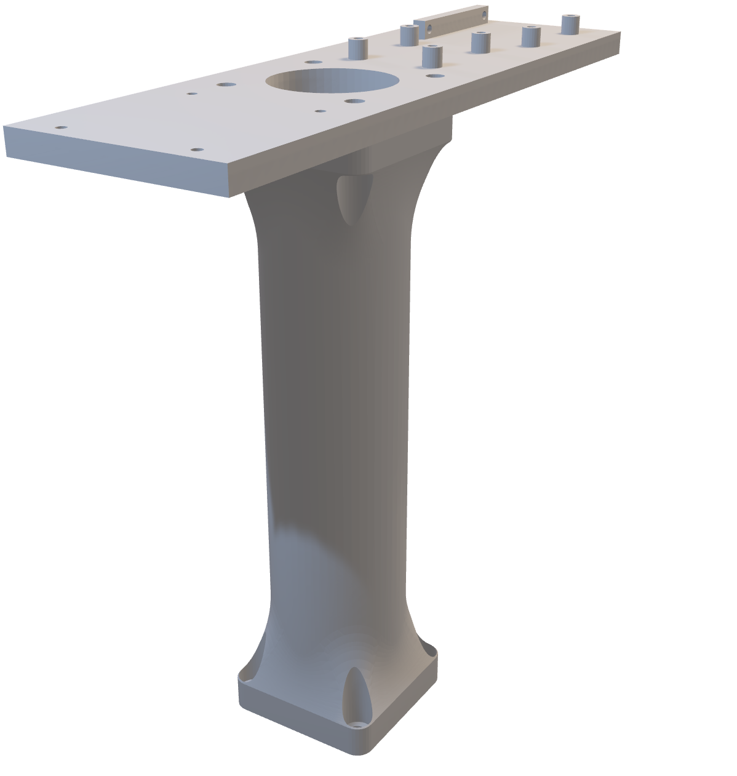
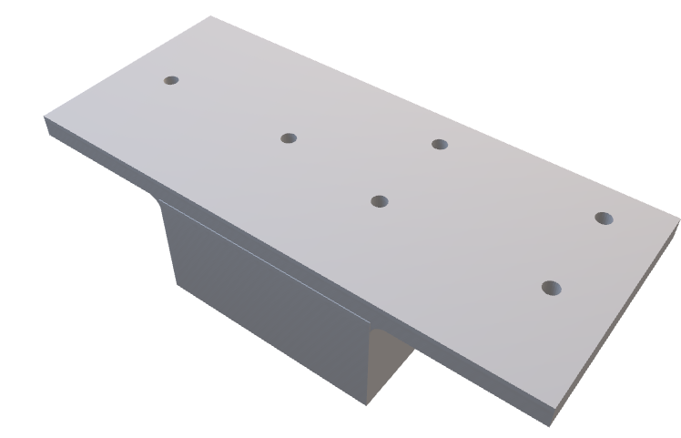
Parts: Head

Slide 10
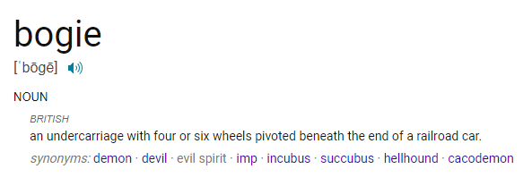

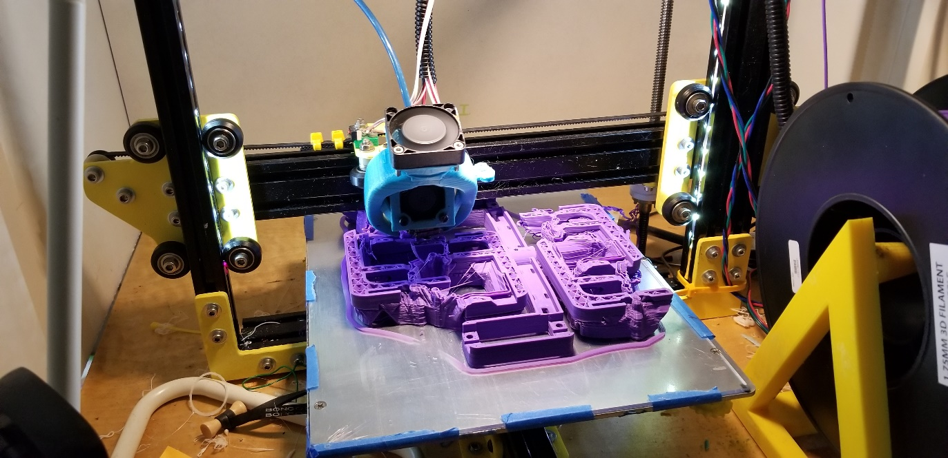
Parts: Bogies

Slide 11
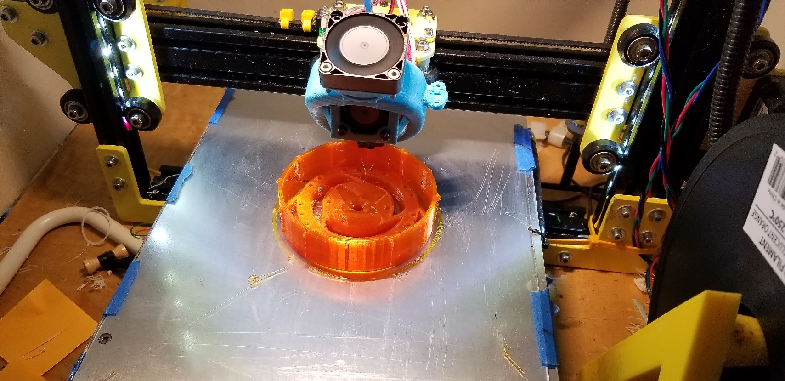
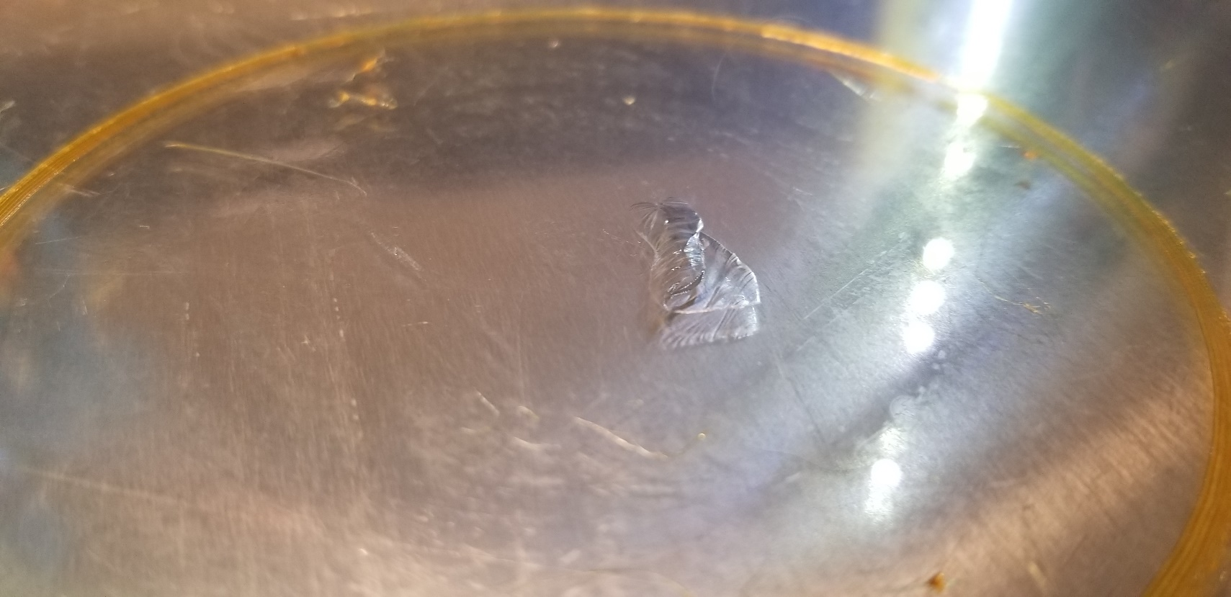
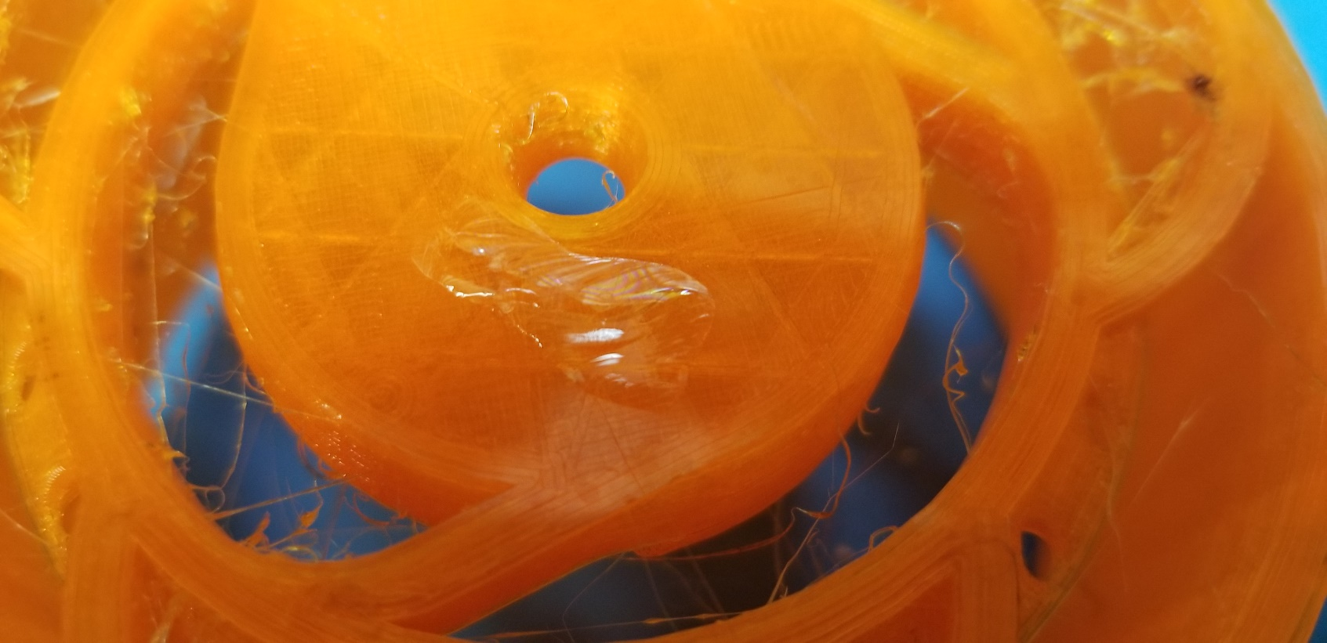
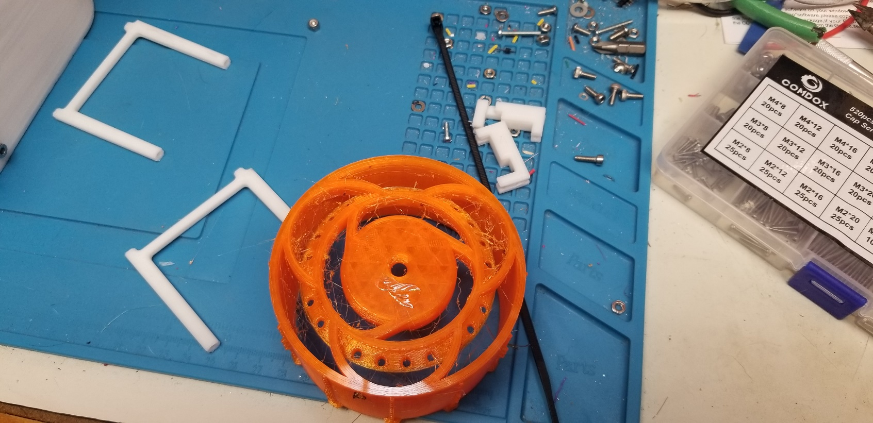
Parts: Wheels

Slide 12

Electronics

Slide 13
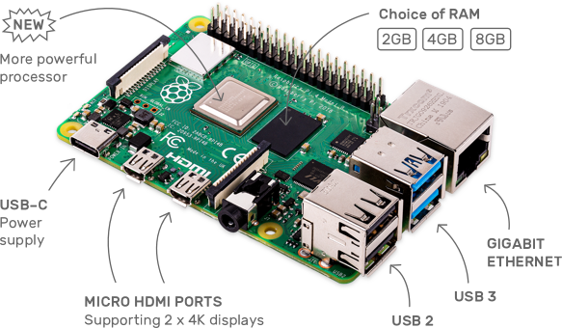
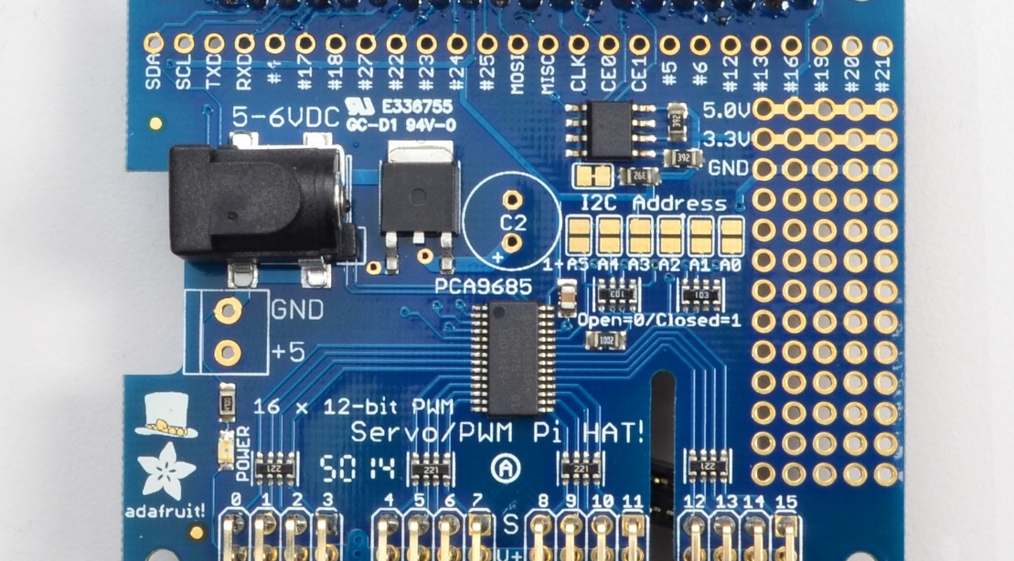
Electronics: The Brain
Images owned by: Buy a Raspberry Pi 4 Model B – Raspberry Pi
Images owned by: Overview | Adafruit 16-Channel PWM/Servo HAT & Bonnet for Raspberry Pi | Adafruit Learning System

Slide 14
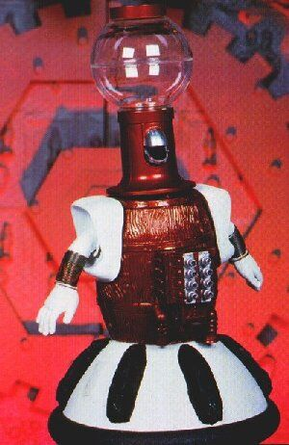
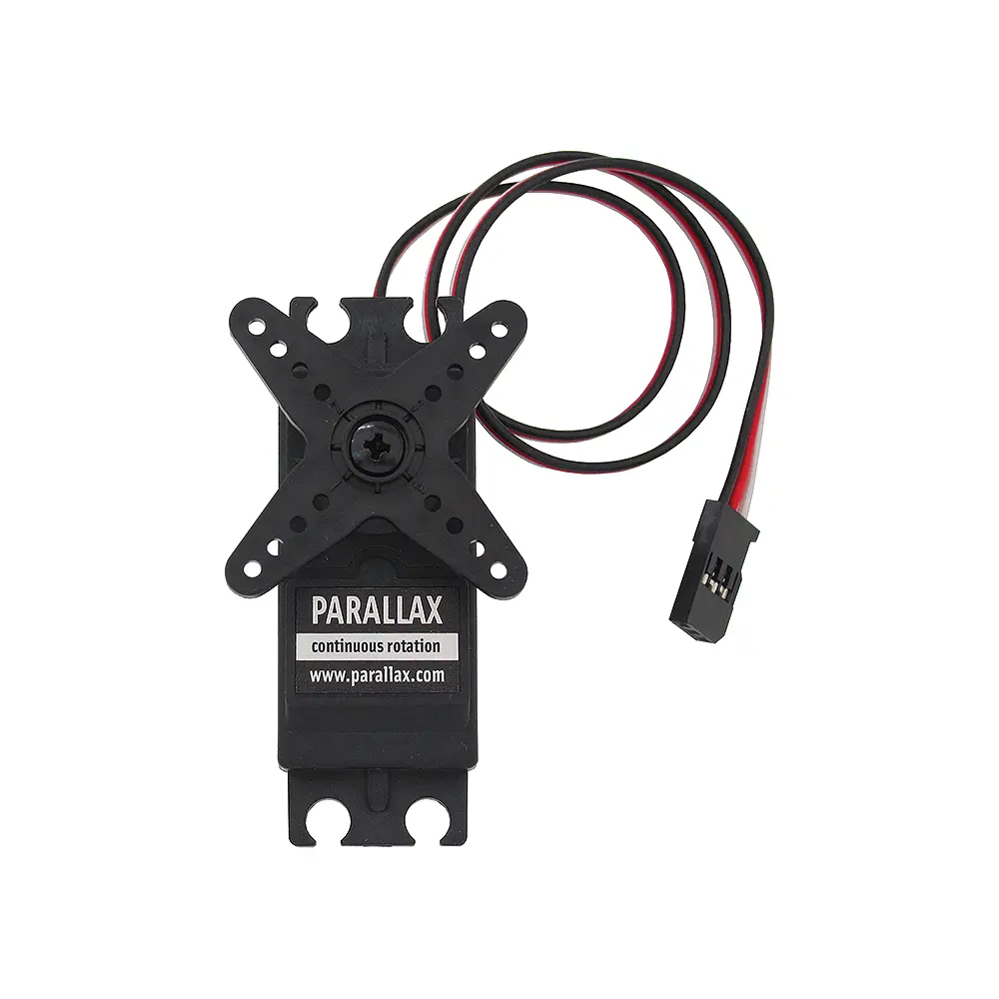
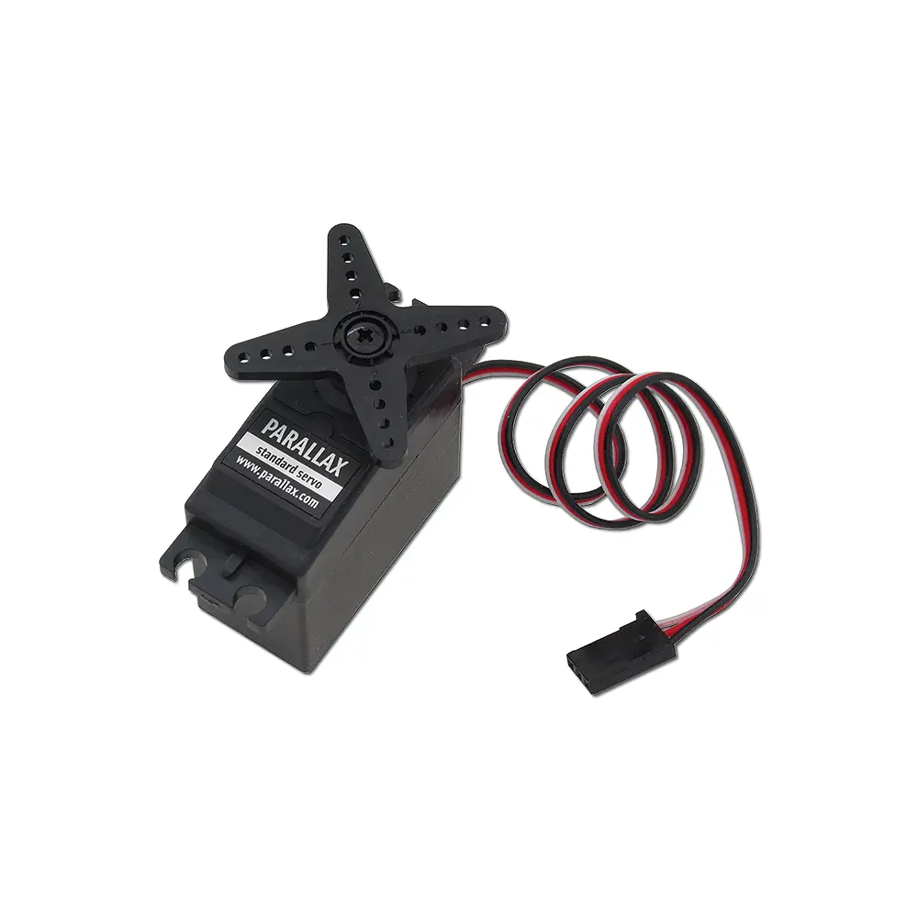

Electronics: Servos

Slide 15
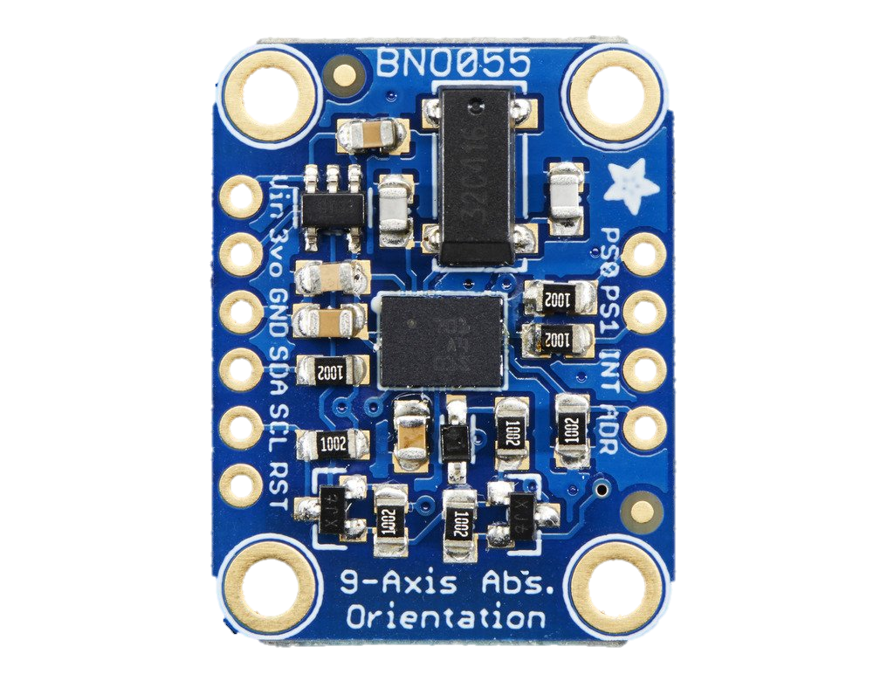
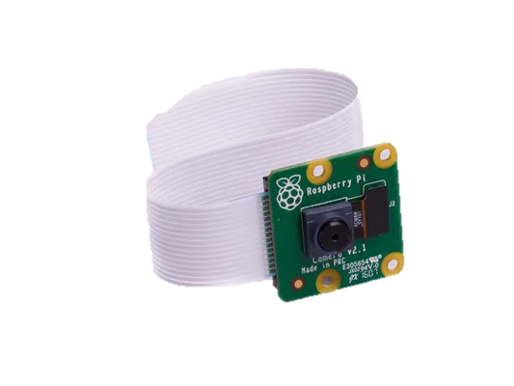
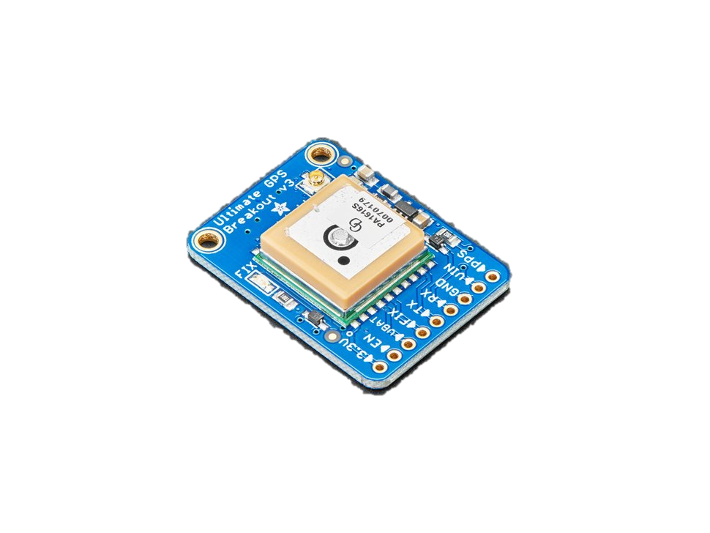
Electronics: Sensors

Slide 16
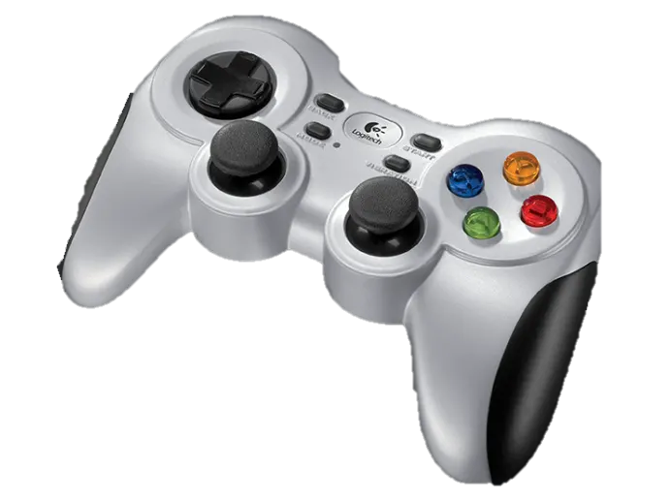
Electronics: Control
Images owned by: F710 Wireless Gamepad - Console Style - Logitech G

Slide 17

Software

Slide 18
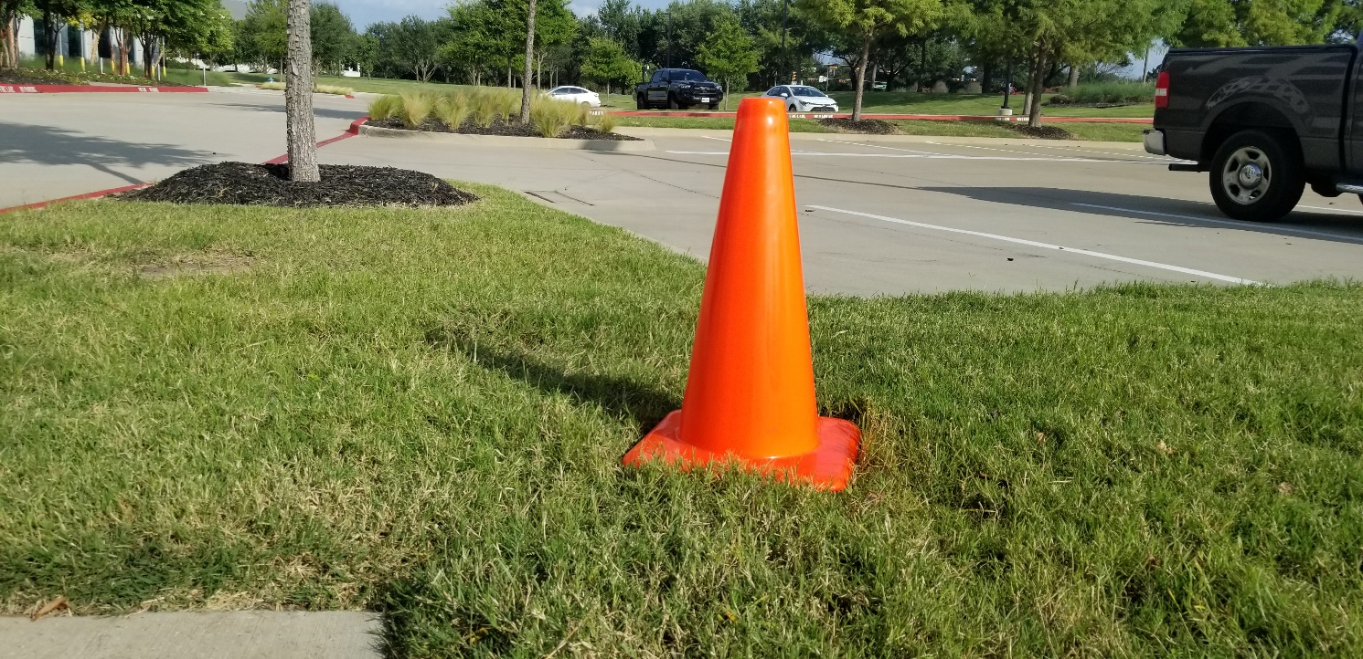
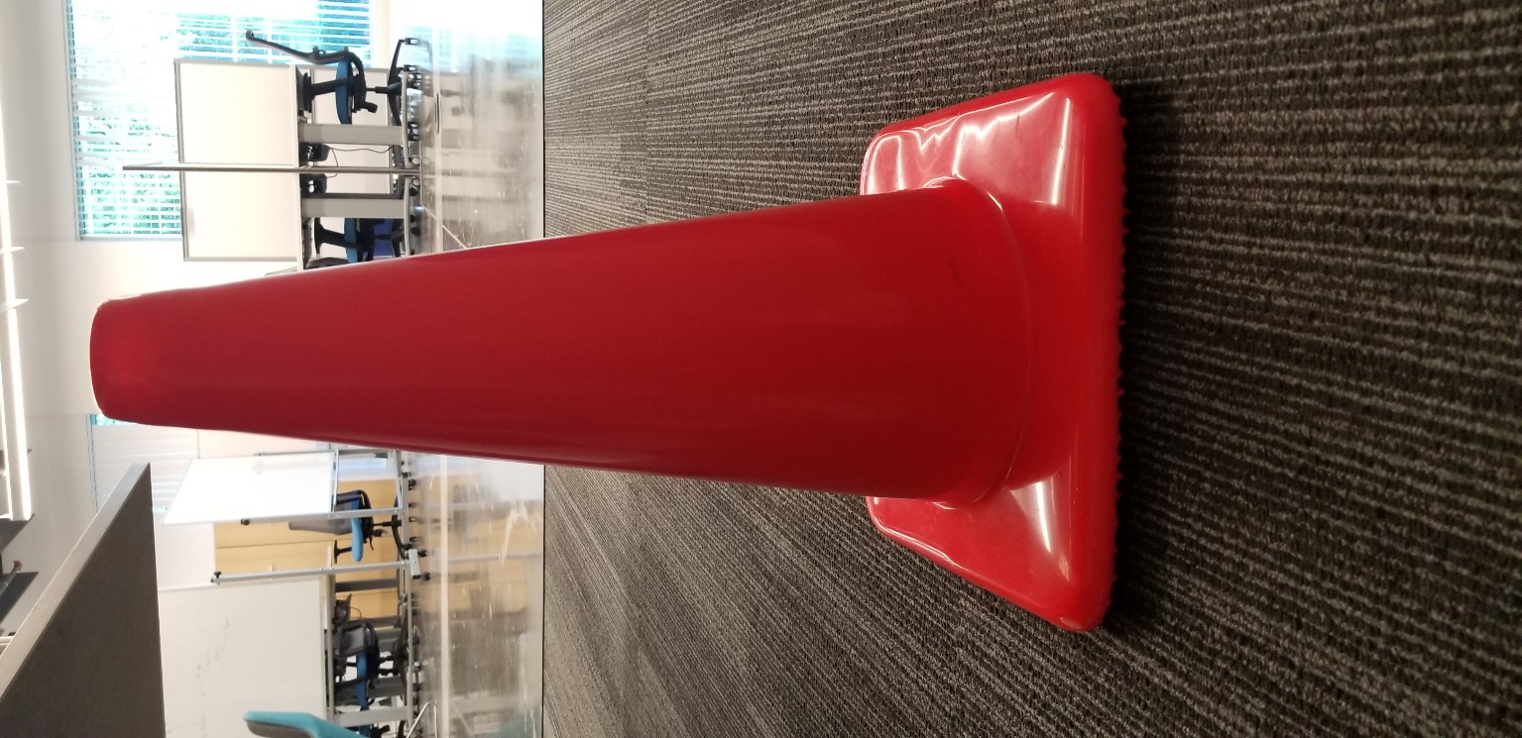
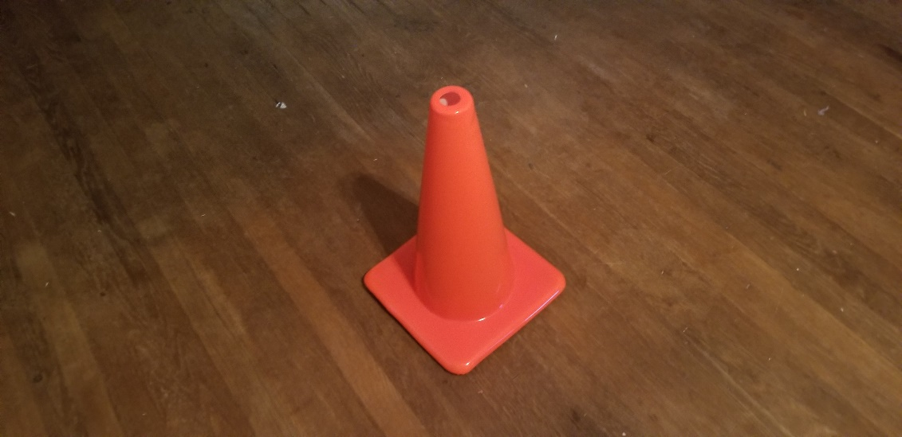
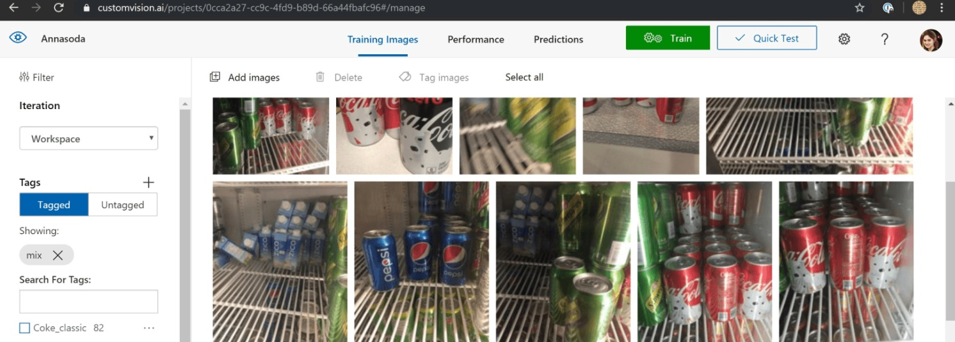
A.I.
Azure Custom Vision: Custom Vision | Microsoft Azure

Slide 19
Some Links to stuff:
Some images by: Parallax Continuous Rotation Servo – Parallax
Tom Servo image by: Tom Servo – Wikipedia

Slide 20
Other Stuff…

